Slide 1
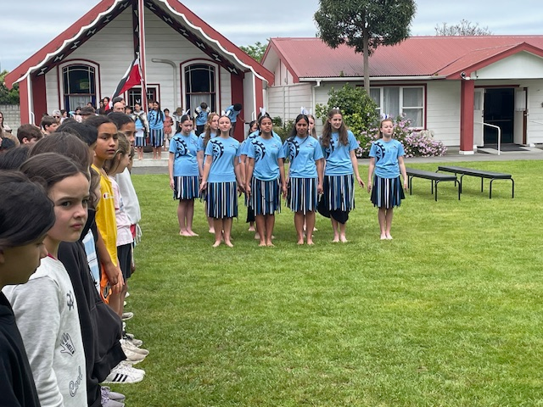
What to expect at a pōwhiri for new students and whānau at Kapakapanui School
Staff and Ngā hau e whā (kapa haka leaders) will arrive early and go to the school hall. They will be inside at the start of the pōwhiri. The front row (paepae) is reserved for the Principal, and speakers. Staff and student leaders will have seats behind the speakers. The tangata whenua (hosts) will stand while the manuhiri (visitors) come in.

Slide 2
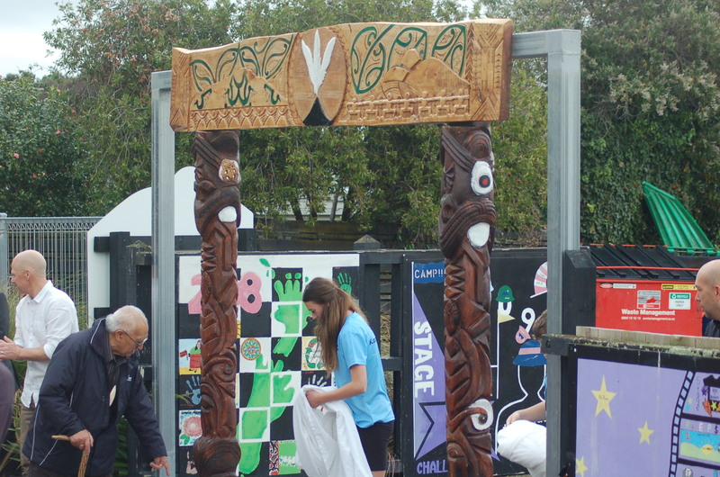
Pōwhiri starts at 9.15am so try to arrive by 9am
New students and any whānau who wish to attend will gather at the waharoa by the school office. There will be a small group of senior students that will walk with you and also karanga and mihi (speak) on your behalf.

Slide 3
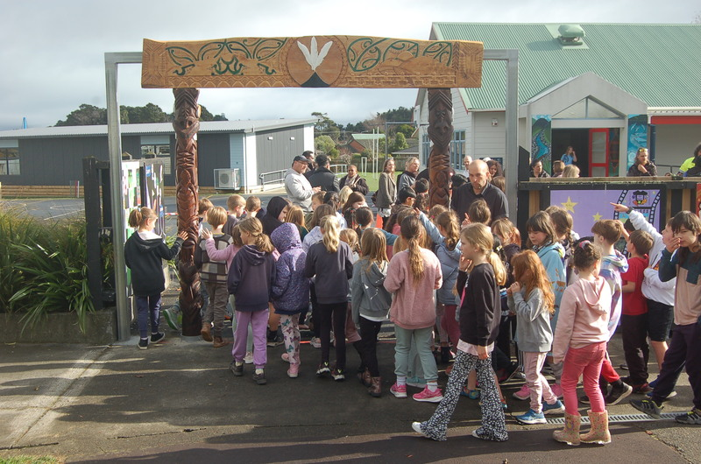
Entry
A karanga (woman's call) from the tangata whenua will signal the start of the pōwhiri. The karanga will go for a long time as everyone walks in. It is a welcoming message. A haka pōwhiri will also follow this.

Slide 4
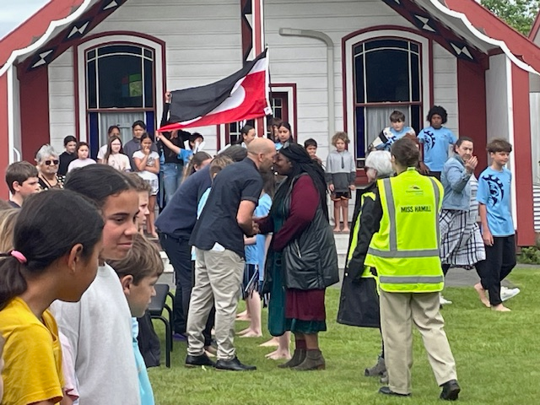
As the manuhiri enter the hall, student leaders and any adults who wish to may hongi (Māori greeting) with the tangata whenua seated at the pae tapu (front seats).
Once inside, parents and whānau should take any available seats, except for the front row, which is reserved for the speakers. These seats are just inside the hall. Once everyone is inside, there will be an invitation to sit—please wait until this invitation before sitting. Most students will need to sit on the floor of the hall.

Slide 5
Next will be the mihi (speeches), which will be delivered in te reo Māori. The first mihi will come from the tangata whenua (hosts), with a senior student speaking. After the speech, the tangata whenua will stand and sing a waiata (Whakataka Te Hau).
The second mihi will be given by Mr. Vidulich (Principal). Following his speech, the tangata whenua will again stand and sing a waiata (Tūtira Mai).

Slide 6
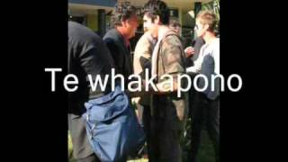
Next, the speaker from the manuhiri (visitors) will stand and speak. When he finishes, all the manuhiri will stand and sing the waiata Te Aroha.
If you would like to speak at the pōwhiri (males only), please let us know before it begins—you are more than welcome to stand and mihi.

Slide 7
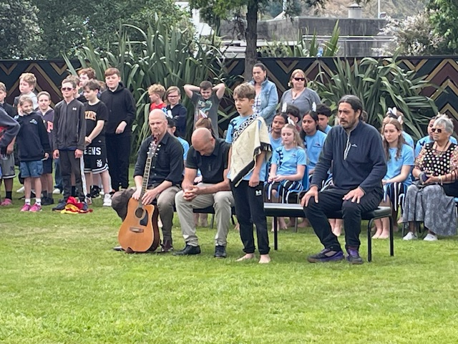
Next, Matua Ngatai will mihi (speak) as the closing speaker. Once he has finished, the tangata whenua will stand and sing our school waiata, Mauri Ora.
After the formalities, Mr. Vidulich will speak in English and explain what happens next.
Parents and whānau are then invited to the staffroom for light refreshments

